Slide 1
Rule System, Fuzzy System
Santosh GSK
Industry Expert

Slide 2
Uncertainty
Propositional Logic and First Order Logic
Facts that can either be True or False
E.g., Delhi is the capital of India
Statements with uncertainty
E.g., There will be rain tomorrow
A coin toss would end up in a tail.

Slide 3
Modeling Uncertainty
Probability Theory
E.g., There will be rain tomorrow [0.4]
A coin toss would give us a tail [0.5]
The expert systems from 1970s used Probability Theory
Couldn’t scale up because of exponential number of probabilities required
Efficient Bayesian Networks were unknown then

Slide 4
Modeling Uncertainty - Alternatives
Rule-based system
Hope to build on the success of logic
Adding a fudge factor to accommodate uncertainty
Methods were developed in mid 1970s
Formed the basis of large number of expert systems in medicine and other areas
Fuzzy Logic
Researches have developed Fuzzy Logic to handle vagueness in an ontology, i.e., proposition can be “sort of” true
Vagueness and uncertainty are orthogonal issues

Slide 5
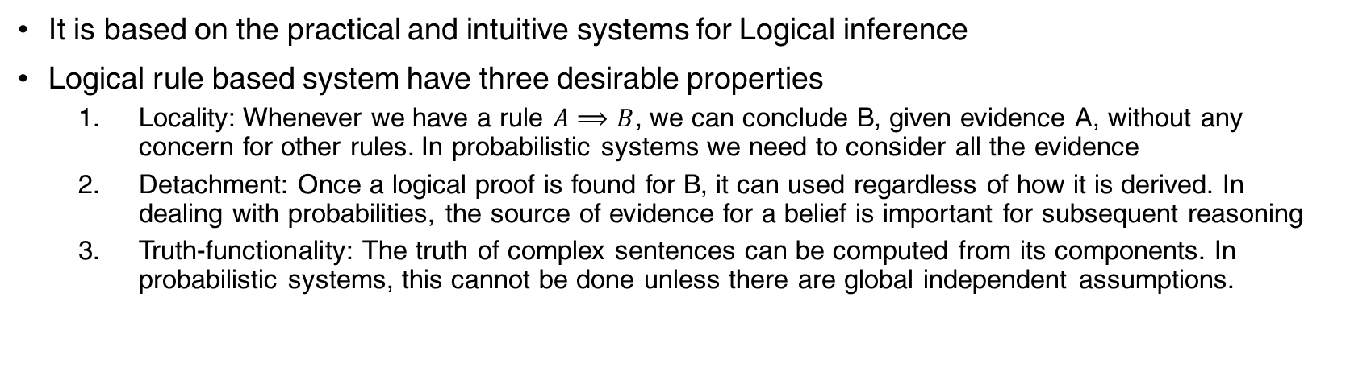
Rule Based System
It is based on the practical and intuitive systems for Logical inference
Logical rule based system have three desirable properties
Locality: Whenever we have a rule $A⟹B$, we can conclude B, given evidence A, without any concern for other rules. In probabilistic systems we need to consider all the evidence
Detachment: Once a logical proof is found for B, it can used regardless of how it is derived. In dealing with probabilities, the source of evidence for a belief is important for subsequent reasoning
Truth-functionality: The truth of complex sentences can be computed from its components. In probabilistic systems, this cannot be done unless there are global independent assumptions.

Slide 6
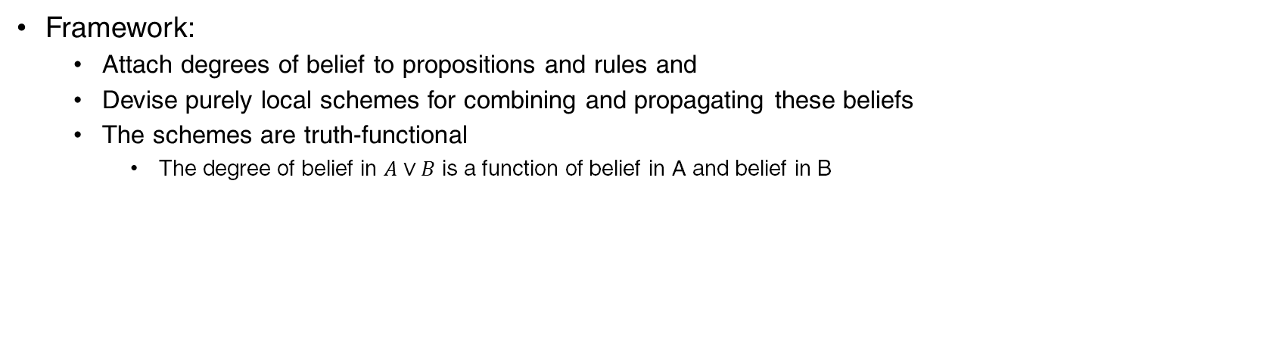
Rule based system
Framework:
Attach degrees of belief to propositions and rules and
Devise purely local schemes for combining and propagating these beliefs
The schemes are truth-functional
The degree of belief in $A∨B$ is a function of belief in A and belief in B

Slide 7
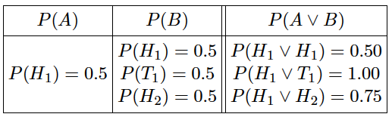
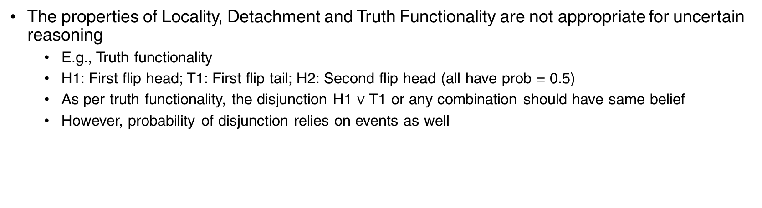
Rule based system
The properties of Locality, Detachment and Truth Functionality are not appropriate for uncertain reasoning
E.g., Truth functionality
H1: First flip head; T1: First flip tail; H2: Second flip head (all have prob = 0.5)
As per truth functionality, the disjunction H1 $∨$ T1 or any combination should have same belief
However, probability of disjunction relies on events as well

Slide 8
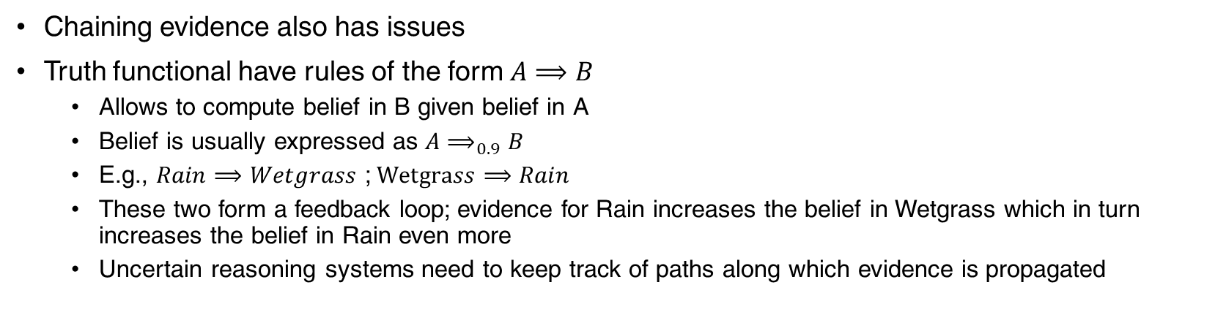
Rule based system
Chaining evidence also has issues
Truth functional have rules of the form $A⟹B$
Allows to compute belief in B given belief in A
Belief is usually expressed as $A⟹_{0.9}B$
E.g., $Rain⟹Wetgrass$ ;$Wetgrass⟹Rain$
These two form a feedback loop; evidence for Rain increases the belief in Wetgrass which in turn increases the belief in Rain even more
Uncertain reasoning systems need to keep track of paths along which evidence is propagated

Slide 9
Rule based System
Given these challenges, truth-functional system need to modified to be useful
Need to restrict the task and carefully engineer the rule base so that undesirable interactions do not occur.
The famous example of truth functional system for uncertain reasoning: Certainty Factors model – developed for MYCIN
A minor variation of Certainty Factors Model was exactly equivalent to Bayesian Inference

Slide 10
Fuzzy Logic
Fuzzy set theory is a means of specifying how well an object satisfies a vague description
E.g., Nate is tall
Is this true if Nate is 5’ 10”?
Most people would hesitate and say “sort of”
Note: this is not a question of uncertainty – we know Nate’s height
Rather it is about the understanding the vagueness of linguistic term “tall”

Slide 11
Fuzzy Set Theory
It is not about uncertain reasoning
It treats “Tall” as a fuzzy predicate and
Says the Truth value of Tall(Nate) is between 0 and 1
Fuzzy set – interpretation of the predicate as implicitly defining a set of its members

Slide 12
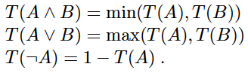
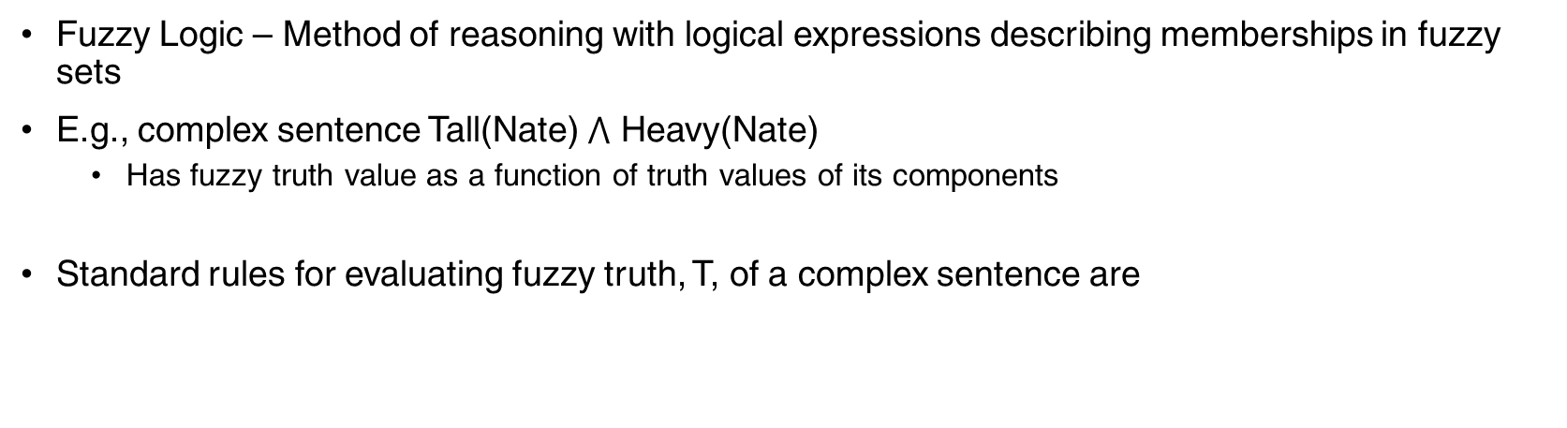
Fuzzy Logic
Fuzzy Logic – Method of reasoning with logical expressions describing memberships in fuzzy sets
E.g., complex sentence Tall(Nate) $⋀$ Heavy(Nate)
Has fuzzy truth value as a function of truth values of its components
Standard rules for evaluating fuzzy truth, T, of a complex sentence are

Slide 13
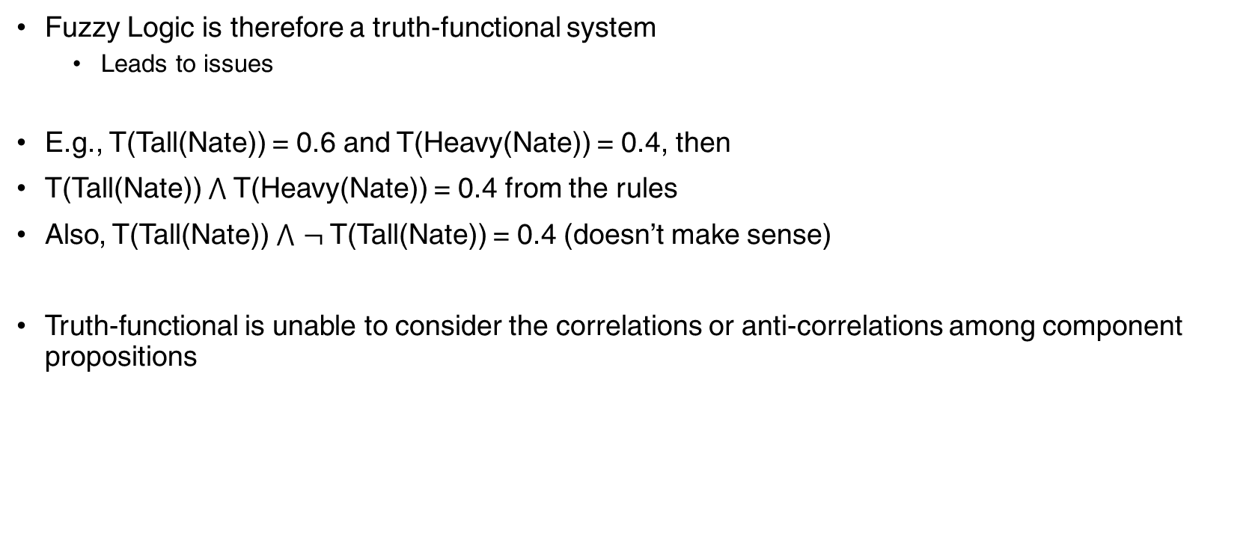
Fuzzy Logic
Fuzzy Logic is therefore a truth-functional system
Leads to issues
E.g., T(Tall(Nate)) = 0.6 and T(Heavy(Nate)) = 0.4, then
T(Tall(Nate)) $⋀$ T(Heavy(Nate)) = 0.4 from the rules
Also, T(Tall(Nate)) $⋀$ $¬$T(Tall(Nate)) = 0.4 (doesn’t make sense)
Truth-functional is unable to consider the correlations or anti-correlations among component propositions

Slide 14
Thank You!
In our next session:
Semantic Nets

Slide 15
Semantic Nets
Santosh GSK
Industry Expert

Slide 16
Representing Complex Knowledge
In Logic, we can represent knowledge as propositions, relations, objects
However, to represent complex aspects of the world, e.g., driving a car, shopping on the internet, we need many levels of representation, i.e., abstractions

Slide 17
Ontological Engineering
Understanding the world’s knowledge in terms of Events, Time, Physical Objects and Beliefs and representing them as abstract concepts

Slide 18
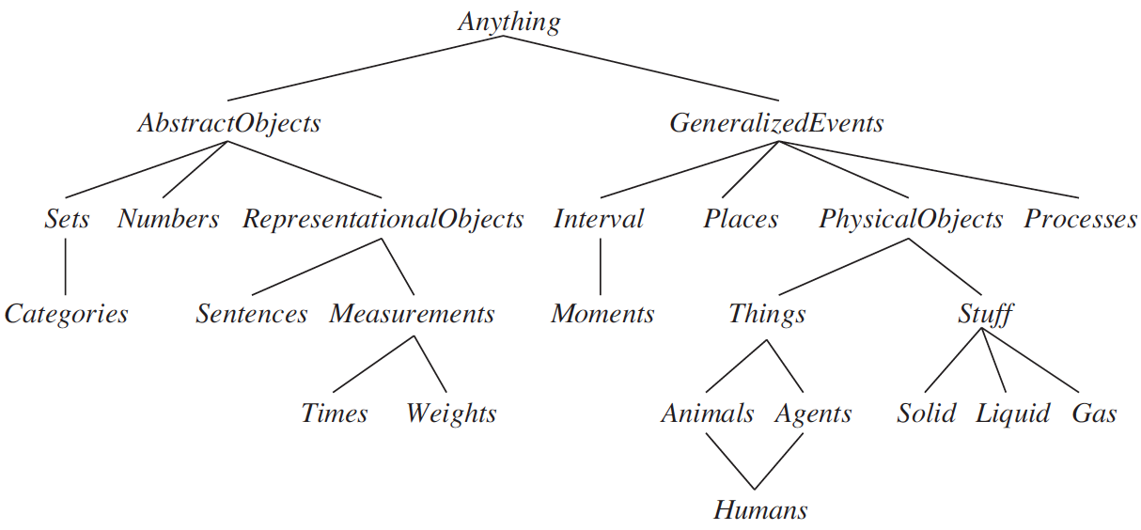
Upper Ontology
General framework of concepts with graphs having general concepts at top and more specific concepts below.

Slide 19
Semantic Net
Semantics: Meaning of concept comes from the ways in which it is connected to other concepts
In Semantic Nets: Information is represented as a set of nodes connected to each other by a set of labeled arcs
The labeled arcs represent the relation between nodes

Slide 20
Semantic Net
Mammal
is-a
Person
has-part
Nose
Instance-of
Uniform color
team
Blue
Pee-Wee-Resse
Brookly Dodgers

Slide 21
Semantic Net
Has a is-a relation
Has a instance-of relation
Using the above net we can determine
has-part(Pee-Wee-Resse, Nose)

Slide 22
Semantic Net: Intersection Search
Intersection Search: Finding relations between two objects by spreading activation out from each of the two node and seeing where they meet
Using this search, we can answer
What is the relation between Brooklyn—Dodgers and Blue
Semantic Net exploits entity-based organization of knowledge which is missing from logic-based agents

Slide 23
Representing non-binary predicates
From the above net, we can infer the following
Instance-of(Pee-Wee-Resse, Person)
Is-a(Person, Mammal)
Has-part(Person, Nose)
Uniform-color(Pee-Wee-Resse, Blue)
Team(Pee-Wee-Resse, Brooklyn—Dodgers)

Slide 24
Representing non-binary predicates
Unary predicates can also be expressed in semantic nets
man(Marcus)
Instance-of(Marcus, man)

Slide 25
Representing non-binary predicates
Three or more place predicates can also be converted to binary form
Create a new object representing the entire predicate statement and
Introduce a binary predicate to describe relationship to this new object of each of original arguments
E.g., score(Cubs, Dodgers, 5-3)
Game
is-a
visiting-team
score
Cubs
G23
5-3
home-team
Dodgers

Slide 26
Distinctive Links
Links can
Define a new entity
Relate two existing entities
John
height
72
John
Bill
height
height
greater-than
H1
H2

Slide 27
Distinctive Properties
Properties of a node can be used
As a value for the node itself
E.g., score(G23, 5-3)
As a value that needs to be inherited by every instance
E.g., has-part(Person, Nose)
However, Person doesn’t have a Nose, it the instance of Person that would have a Nose

Slide 28
Thank You!
In our next session:
Classes. Objects and Events

